Slide 1
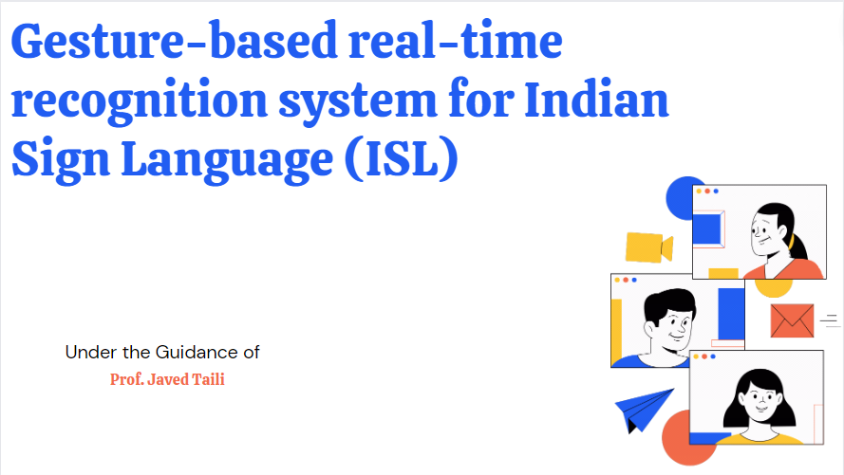

Slide 2

M. H. Saboo Siddik College of Engineering
University of Mumbai
2022 - 2023
Our esteemed Group members :-
4119006
4119007
4119008
ADVAIT GURUNATH CHAVAN
4119009
AAKASH NANKHURAM GUPTA
HAMZA SHAKEEL ANSARI
TAJ MOHAMMED SHAH

Slide 3
Abstract
This project presents a system that can recognize Indian Sign Language (ISL) hand poses and gestures performed by deaf and dumb people in real time and interpret/translate them into them English text readable to normal people for better and efficient communication within the society.
The existing solutions are either of high cost of purchase and maintenance which cannot be afforded by most of the deaf and dumb people of India in particular. Also, the existing solutions have a low accuracy and low speed of operation which will have an effect on the real-time analysis, interpretation and translation of the sign language to a language which shall be understandable by the physically normal people.
Our proposed system has the ability to overcome both the above-mentioned problems i.e. Accurate Results and Time Factor. It can identify 35 ISL gestures along with some hand poses.

Slide 4
Problem Statement
Understanding the exact context of symbolic expressions of deaf and dumb people is the challenging job in real life until and unless it is properly specified.
To fill the bridge between the communication process between the deaf and dumb people and normal people using the most effective, fast and low-cost method.

Slide 5
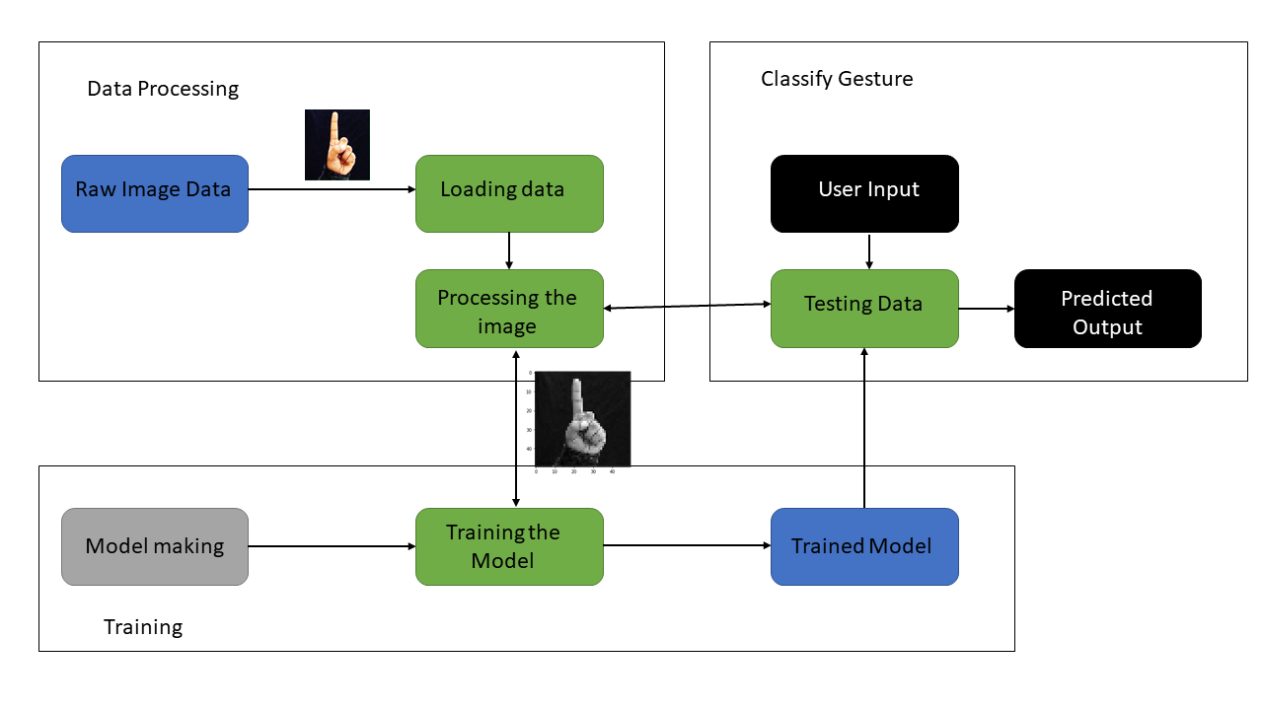
Design Methodology / Block Diagram

Slide 6
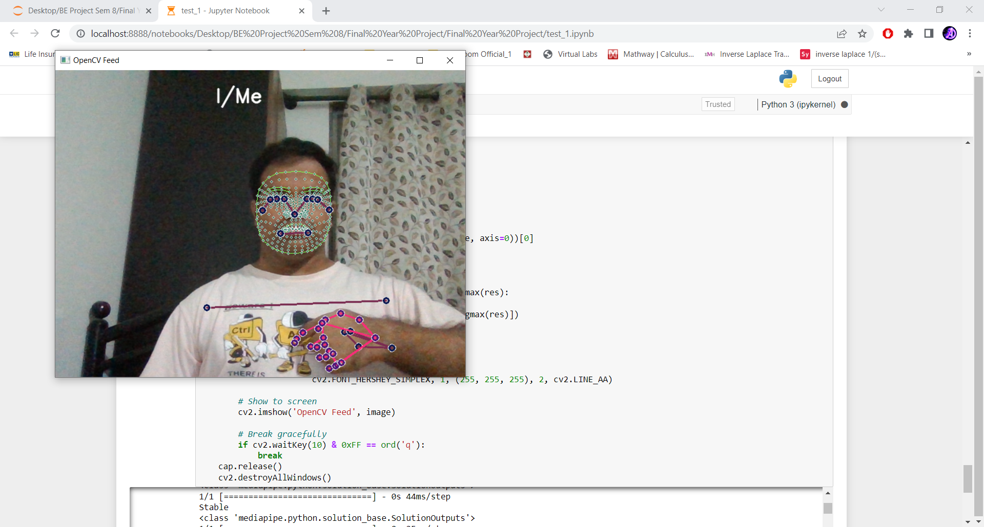

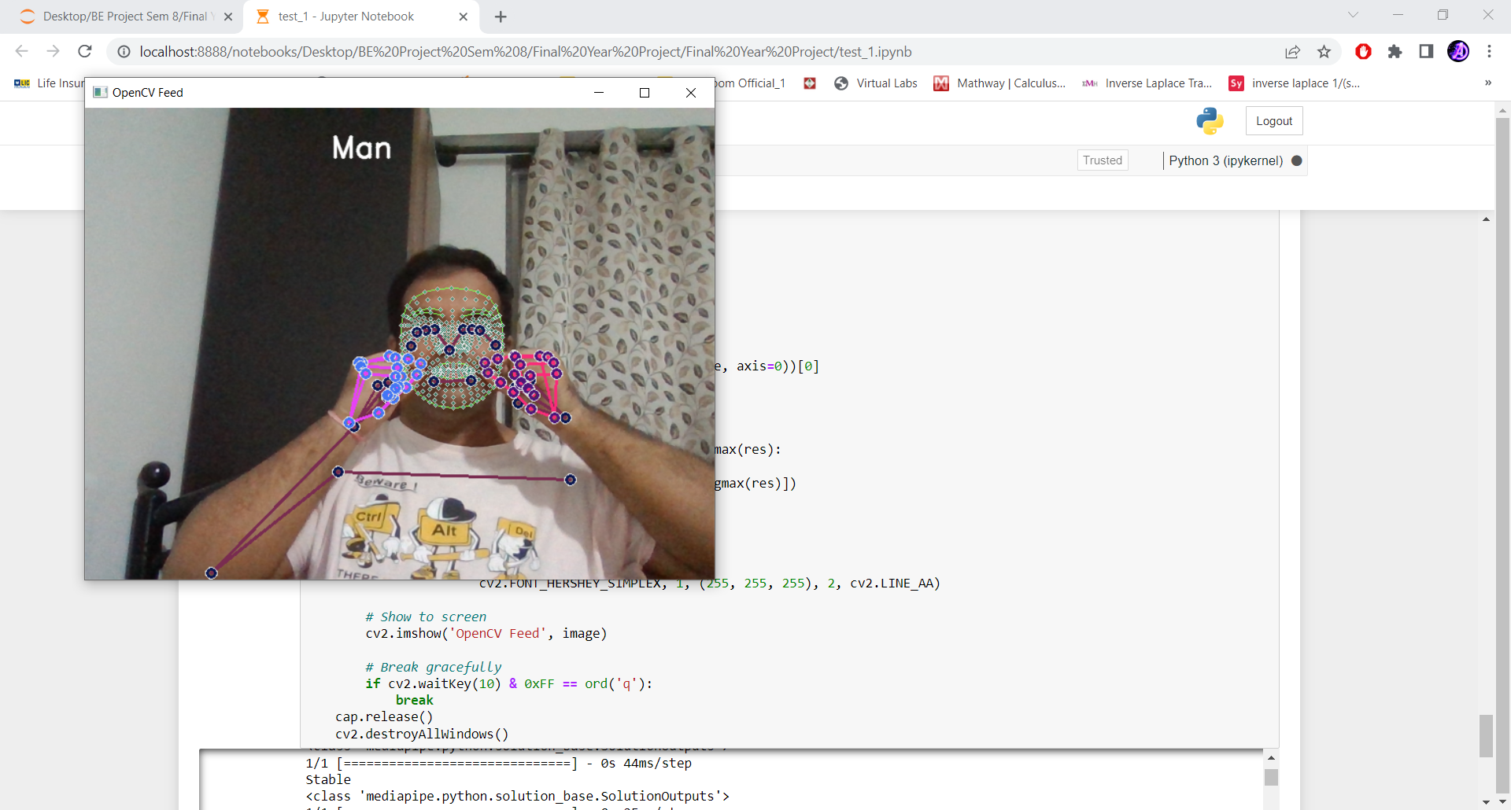
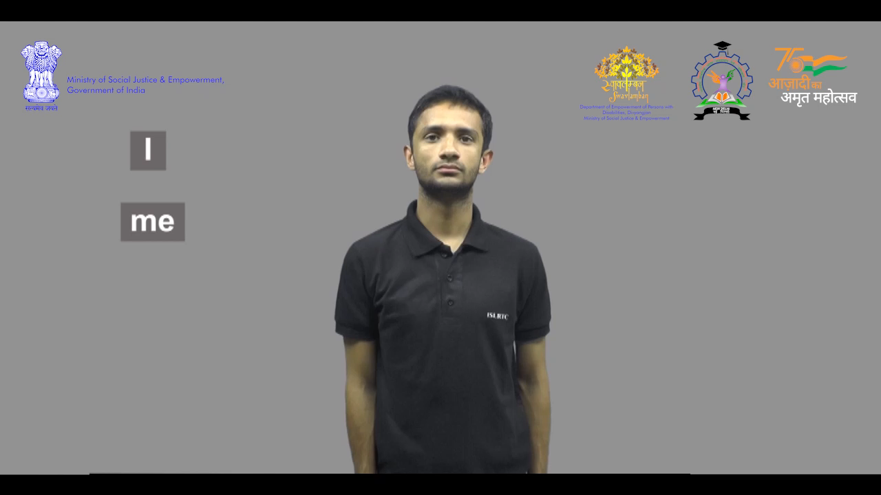
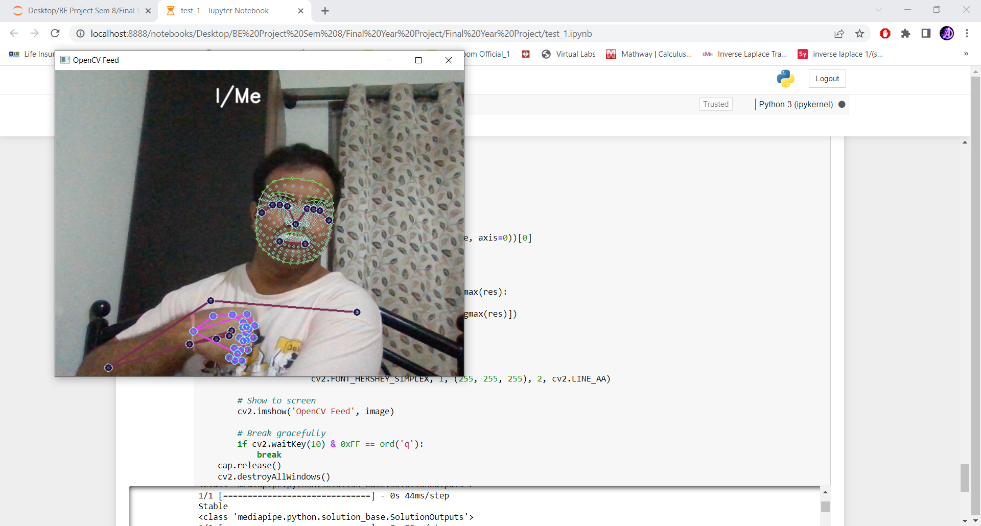
Simulation and Experimental Results
Experimental Output
Desired Output

Slide 7
Problems faced : -
Since we are in the final year and it would be soon ended in 3-4 months, during this tenure as a student we are required to complete our TW, prepare ourselves for Internal (IAE 1, IAE 2), VIVA, End Sem Exam(ESE) along with Internships, Interview Preparation, etc. it has difficult for us to come together on Friday; this is because we need minimum of 3 days to complete the TW, prepare ourselves for the different levels of hiring process. The solution to the above mentioned problem would be to please allow the students who ever are willing to sit in any of the labs(Under the command of the Electronics Department) available till 5:30 PM on Mondays, Tuesdays, Wednesdays and Thursdays. Department of Automobile Engineering has granted the students to use their labs at the ground floor and their making the most of it.
Regarding the Project the major problems faced were Data collection and improving the accuracy.

Slide 8
References
[1] A. Agarwal and M. K. Thakur, “Sign Language Recognition using Microsoft Kinect,” Sixth International Conference on Contemporary Computing (IC3), September 2013.
[2] MailOnline, ‘'SignAloud gloves translate sign language gestures into spoken English,” 2016. [Online]. Available: http://www.dailymail.co.uk/sciencetech/article-3557362/SignAloudgloves-translate-sign-language-movements-spoken-English.html. . [Accessed: 25- Sept- 2022].
[3] Alexia. Tsotsis, “MotionSavvy Is A Tablet App That Understands Sign Language,” 2014. [Online]. Available: https://techcrunch.com/2014/06/06/motionsavvy-is-a-tablet-app-thatunderstands-sign-language/. [Accessed: 10 – Oct- 2022].

Slide 9
[4] R. Y. Wang and J. Popovic, “Real-Time Hand-Tracking with a Color Glove,” ACM transactions on graphics (TOG), vol. 28, no. 3, 2009.
[5] F. S. Chen, C. M. Fu and C. L. Huang, "Hand gesture recognition using a real-time tracking method and hidden Markov models", Image and vision computing, vol. 21, pp. 745-758, 2003.
[6] M. A. Rahaman , M. Jasim, M. H. Ali and M. Hasanuzzaman, “RealTime Computer Vision-Based Bengali Sign Language Recognition,” 17th International Conference on Computer and Information Technology (ICCIT), 2014.
[7] S. Padmavathi, M. S. Saipreethy and V. Valliammai, “Indian Sign Language Character Recognition using Neural Networks,” IJCA Special Issue on Recent Trends in Pattern Recognition and Image Analysis RTPRIA, 2013.
[8] A. Chaudhary, J. L. Raheja and S. Raheja, “A Vision based Geometrical Method to find Fingers Positions in Real Time Hand Gesture Recognition,” JSW, pp. 861-869, 2012.

Slide 10
Thankyou…..

